Slide 1

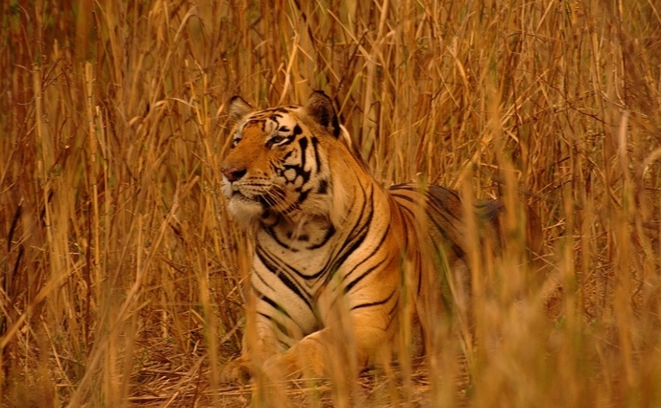
Adaption of XCS to Multi-Learner Predator/Prey Scenarios
Clemens Lode, Urban Richter, Hartmut Schmeck
Karlsruhe Institute of Technology (Germany)
Institute AIFB
July, GECCO 2010
http://www.flickr.com/photos/shreeram

Slide 2
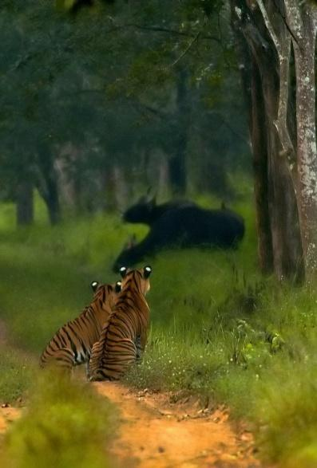
Outline
Learning Classifier Systems
XCS in Predator/Prey Scenarios
Adapting the Reward Function
Experimental Results
http://www.flickr.com/photos/yathin

Slide 3
Environment
Input: 0011
Population [P]
C A ρ ε F
#011 : 01 43 .01 99
11## : 00 32 .13 9
#0## : 11 14 .05 52
001# : 01 27 .24 3
#0#1 : 11 18 .02 92
1#01 : 10 24 .17 15
…
Action: 01
Reward
Prediction array
Action set [A]
Match set [M]
Action
selection
00 01 10 11
nil 42.5 nil 16.6
#011 : 01 43 .01 99
001# : 01 27 .24 3
#011 : 01 43 .01 99
#0## : 11 14 .05 52
001# : 01 27 .24 3
#0#1 : 11 18 .02 92
Max
Discount
+
Delay = 1
P
Previous
action set [A]₋₁
Genetic
operators
Covering
Update ρ ε F
Wilson, S. W. Koza, J. R. & others (ed.) Generalization in the XCS Classifier System Genetic Programming 1998: Proceedings of the Third Annual Conference, 1998, 665-674

Slide 4
Learning Classifier Systems
Standard (Multi-Step) Problem:
Maze6
Goal:
Find shortest path to the food starting from a random point
T: Tree
F: Food

Slide 5
Learning Classifier Systems
Problem:
Limited sensors, no global knowledge
Partially observable Markov decision process
Solution:
Iterations, back-propagation of reward
T: Tree
F: Food

Slide 6
Learning Classifier Systems
Problem:
Limited sensors, no global knowledge
Partially observable Markov decision process
Solution:
Iterations, back-propagation of reward
Aliasing positions:
Handle by using memory
T: Tree
F: Food

Slide 7
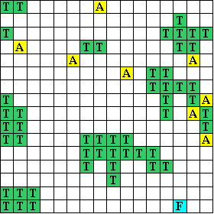
Learning Classifier Systems
Many aliasing positions
Other agents present
Dynamic world
food and other agents move
Limited sensors
T: Trees
F: Food
A: Agent

Slide 8
Predator/Prey Scenarios
Terminology:
Obstacles, Prey, Predator
Goal: Get near the moving prey as often as possible
Global observation task
Continuous
Average Quality
T: Trees/Obstacles
F: Food/Prey
A: Agent/Predator

Slide 9
Classification of Predator/Prey Scenarios
Access to local information only
open areas with some obstacles
internal state unknown to others
No standard MDP
Limited sensors (1, 3)
Aliasing positions (2)

Slide 10
Classification of Predator/Prey Scenarios
Access to local information only
open areas with some obstacles
internal state unknown to others
dynamic scenario
No standard MDP
Limited sensors (1, 3)
Aliasing positions (2)
No POMDP
Non-static scenario (4)

Slide 11
Classification of Predator/Prey Scenarios
Access to local information only
open areas with some obstacles
internal state unknown to others
dynamic scenario
predators share global observation task
runs continuously
No standard MDP
Limited sensors (1, 3)
Aliasing positions (2)
No POMDP
Non-static scenario (4)
XCS has to be adapted
No “final” reward (5), no iterations (6)

Slide 12
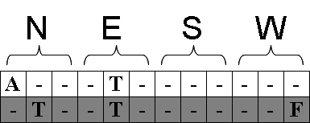
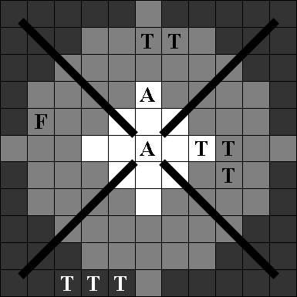
Sensors
One sensor array for each direction

Slide 13
Sensors
One sensor array for each direction
Sensors can sense either far or near

Slide 14
Sensors
Sensors can sense either far or near (observation range / sight range)
Sensors can distinguish between Predators, Prey and Obstacles
One sensor array for each direction

Slide 15
Adaption of the standard XCS Reward Function
Standard implementation:
Adapted implementation

Slide 16
Adaption of the standard XCS Reward Function
Standard implementation:
Reward:
Food is in a neighboring cell
Adapted implementation
Reward:
Food is in observation range (“XCS obs”)
Food is in sight range (“XCS sight”)

Slide 17
Adaption of the standard XCS Reward Function
Standard implementation:
Reward:
Food is in a neighboring cell
Action:
Assign reward
Restart scenario
Switch between explore/exploit phase
Adapted implementation
Reward:
Food is in observation range (“XCS obs”)
Food is in sight range (“XCS sight”)
Action:
Assign reward
Continue scenario
Always use exploit phase

Slide 18
Classification of Predator/Prey Scenarios
Global knowledge cannot be reconstructed
Memory becomes invalid after each step
The predator/prey scenario is a Non-observable Markov Decision Processes

Slide 19
Classification of Predator/Prey Scenarios
Global knowledge cannot be reconstructed
Memory becomes invalid after each step
The predator/prey scenario is a Non-observable Markov Decision Processes
Despite being a NOMDP, can the XCS still learn?

Slide 20
Classification of Predator/Prey Scenarios
Global knowledge cannot be reconstructed
Memory becomes invalid after each step
The predator/prey scenario is a Non-observable Markov Decision Processes
Despite being a NOMDP, can the XCS still learn?
Yes, the prey does move only a limited number of cells
→ The environment does not completely change each turn

Slide 21
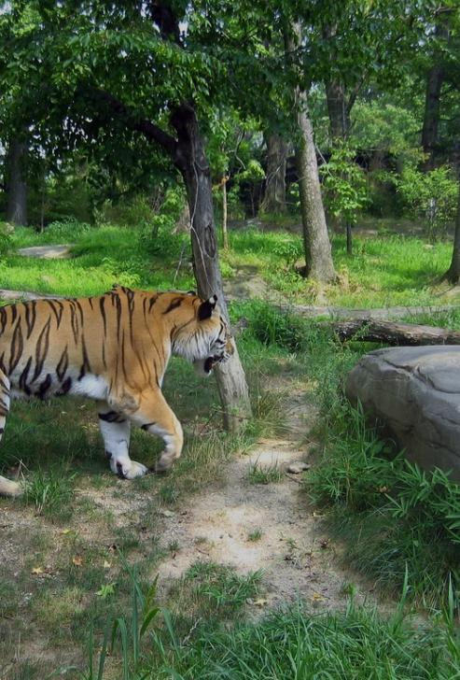
Testing Methodology
“XCS obs”, “XCS sight”
“Obstacle-evading prey”
“Predator-evading prey”
“Blinded Prey”
Standard XCS parameter settings
http://www.flickr.com/photos/james_crowley

Slide 22
Scenario Configurations
Three different scenarios with observation and sight ranges
“Pillar scenario”
“Random scenario”
“Difficult scenario”

Slide 23
XCS Experimental Results “Pillar Scenario”
XCS (obs) shows some learning
Obstacle-evading prey
Predator-evading prey

Slide 24
XCS Experimental Results “Random Scenario”
XCS shows very little learning
Obstacle-evading prey
Predator-evading prey

Slide 25
XCS Experimental Results “Difficult Scenario”
XCS shows significant learning
But also unlearning after 8,000 steps
“Difficult Scenario” is a maze-like scenario, this result was expected
Blinded prey

Slide 26
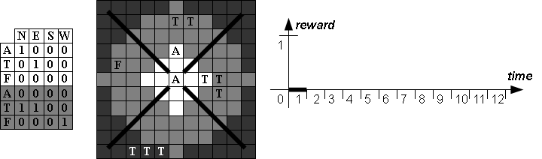
Base Reward and Reward Events

Slide 27
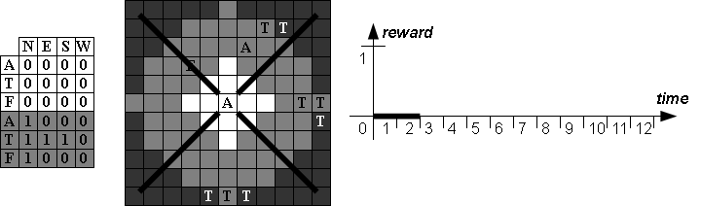
Base Reward and Reward Events

Slide 28
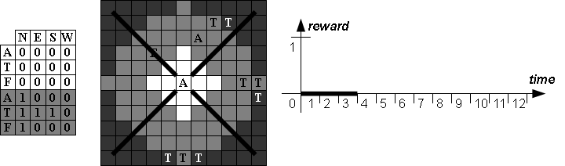
Base Reward and Reward Events

Slide 29
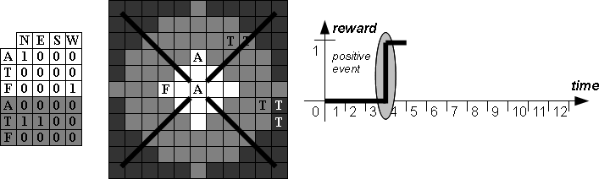
Base Reward and Reward Events

Slide 30
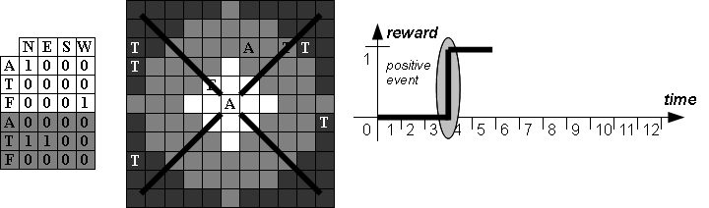
Base Reward and Reward Events

Slide 31

Base Reward and Reward Events

Slide 32
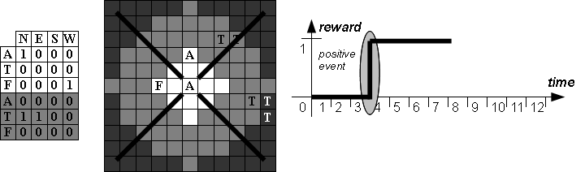
Base Reward and Reward Events

Slide 33
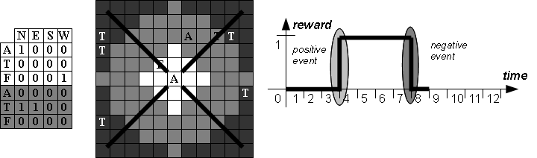
Base Reward and Reward Events

Slide 34
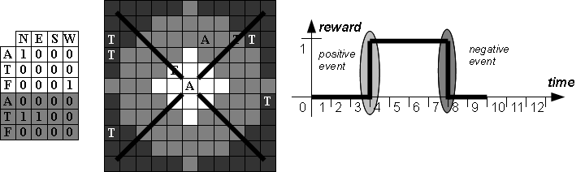
Base Reward and Reward Events

Slide 35
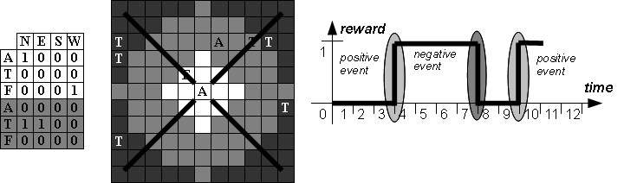
Base Reward and Reward Events

Slide 36
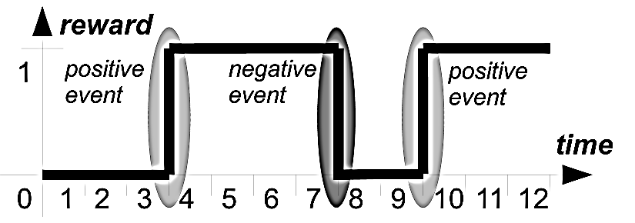
Reward Distribution
Analyze succession of positive and negative events

Slide 37
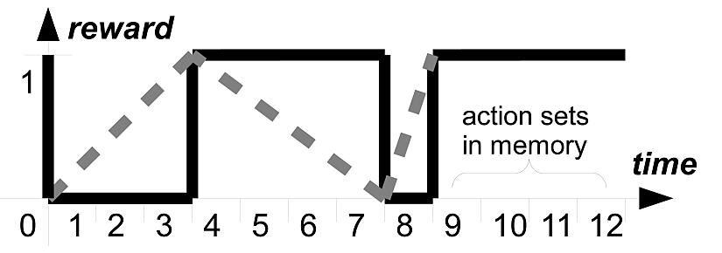
Reward Distribution
Analyze succession of positive and negative events
Distribute the reward as soon as possible (i.e. at each event)
Idea:
Action sets closer to an event probably contributed more

Slide 38
eventXCS
Adaption of XCS to Multi-Learner predator/prey scenarios
“eventXCS”
Reward events
Reward distribution

Slide 39
eventXCS Experimental Results “Pillar Scenario”
eventXCS clearly outperforms XCS
Obstacle-evading prey
Predator-evading prey

Slide 40
eventXCS Experimental Results “Random Scenario”
eventXCS shows slow but steady learning with an obstacle-evading prey
Obstacle-evading prey
Predator-evading prey

Slide 41
eventXCS Experimental Results “Difficult Scenario”
eventXCS fails in this scenario
Using “tournament selection” it shows acceptable results with no sign of unlearning
Blinded prey

Slide 42
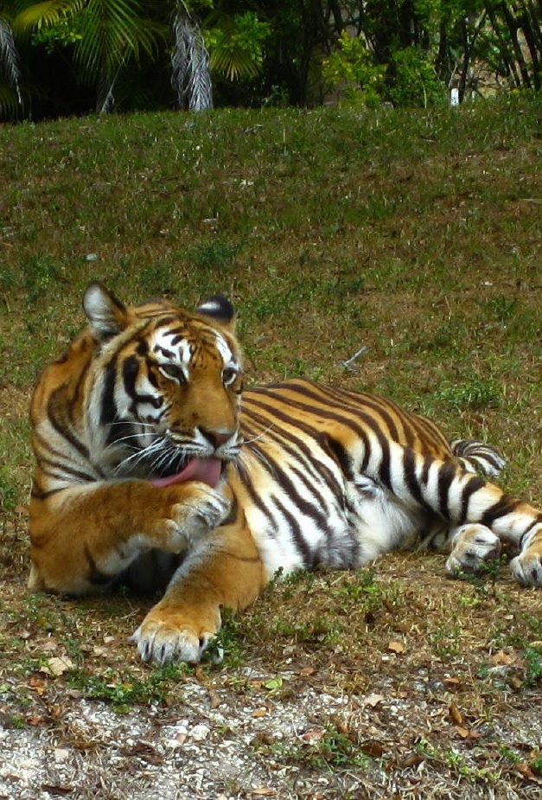
Conclusion

Slide 43

Adaption of XCS to Multi-Learner Predator/Prey Scenarios
Thank you for your attendence!
Questions?

Slide 44
Backup slides

Slide 45
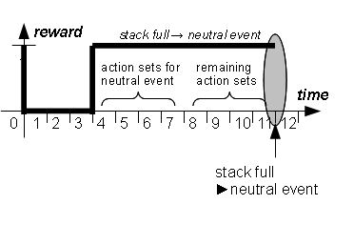
Neutral Events
Neutral Event
No positive or negative event for a number of steps
Half of the action sets is discarded and receives reward
Idea:
Good actions are rewarded earlier
Preventing of dead ends
45

Slide 46
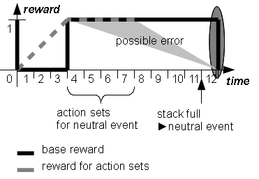
Neutral Events
Neutral Event
No positive or negative event for a number of steps
Half of the action sets is discarded and receives reward
Idea:
Good actions are rewarded earlier
Preventing of dead ends
Problem:
Error possibility high if directly followed by an event.
46

Slide 47
Neutral Events
Tests have shown that a stack size of 8 is generally good for all three scenarios
“Pillar Scenario”
“Random Scenario”
“Difficult Scenario”

Slide 48
Learning Rate β
Pillar Scenario
Obstacle-evading prey
Low learning rate (0.05) good, eventXCS very stable

Slide 49
Learning Rate β
Random Scenario, Obstacle evading prey
Pillar Scenario Predator-evading prey
Random Scenario, Predator evading

Slide 50
Learning Rate β
Difficult Scenario
Blind prey
High learning rates show an advantage because of long distance to the prey

